Slide 1
Smart Investing Decision Making using ANN, Machine Learning, Indicators and Oscillators
-Our Guide:
Mr. Partha Sarathi Chakraborty
Name Phone No. Mail_ID
Mohit Sehgal 9756801893 Sehgal.mohit06@gmail.com
Pranav Puri 8860270019 Pranav_sulesh@srmuniv.edu.in
Umesh Verma 8826889808 Umesh.mr.72@gmail.com
Toyaz Pareek 7725908299 Toyazpareek@gmail.com

Slide 2
Introduction
•This project is aimed at developing a smart investing decision making while investing in a stock by combining various technical analysis indicators and oscillators, ANN, Statistical Regression.

Slide 3
Technologies and Tools
Python
Java
Statistics

Slide 4
List of Indicators and Oscillators
SMA
EMA
MACD
Bollinger Band
RSI

Slide 5
SMA
A simple moving average is an indicator that calculates the average price of a security over a specified number of periods.
It is a lagging indicator.

Slide 6
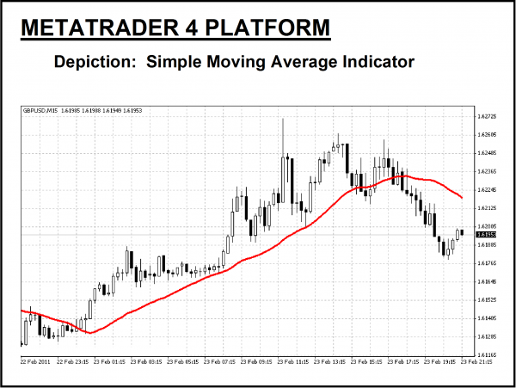
How SMA can help Investors?
Identify direction of trend- bullish(uptrend) or bearish(downtrend)
Buy signal and sell signal

Slide 7
EMA
It gives more weight to more recent prices.
It results is a moving average line that more closely follows changes in the stock price as the bars form.

Slide 8
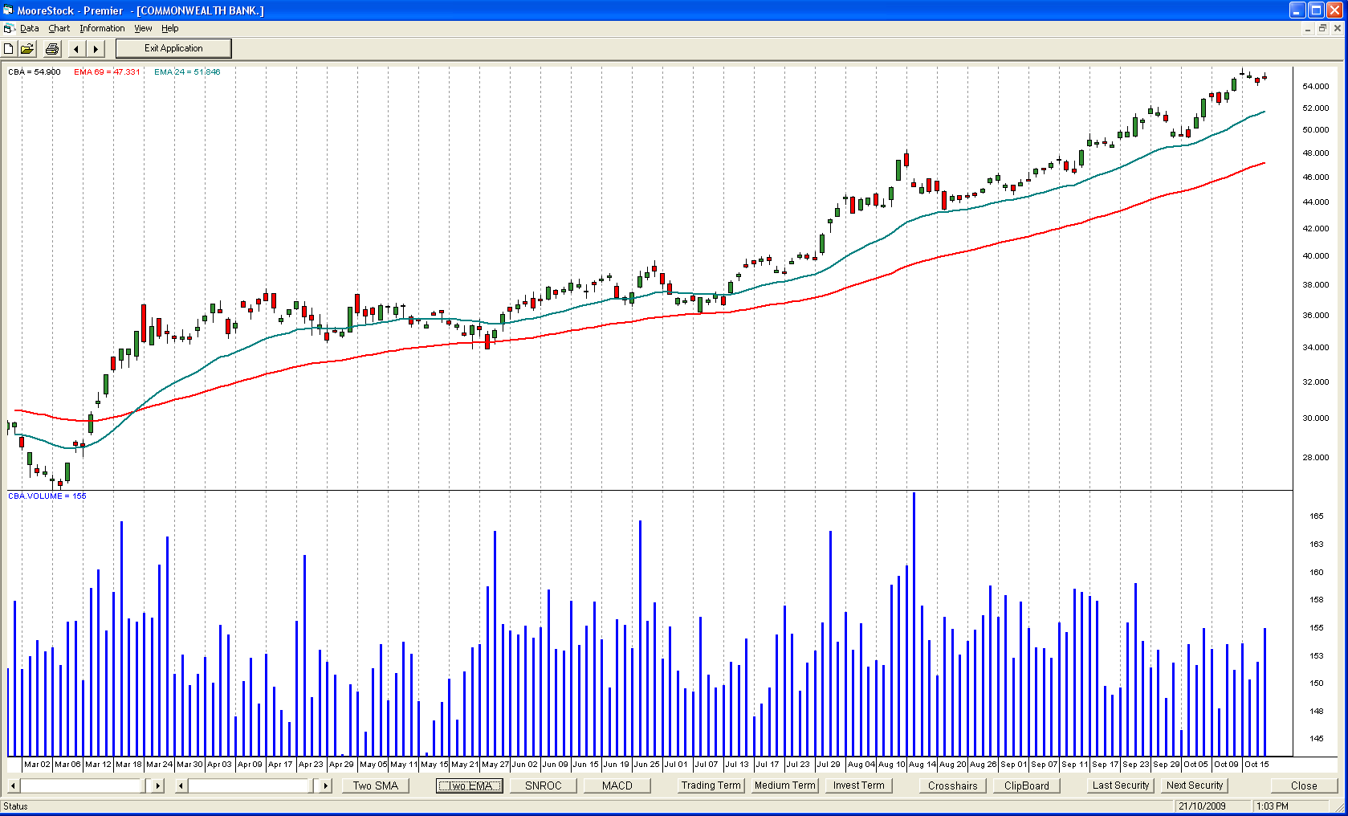
How EMA can help investors or traders?
Identifying bullish or bearish market
Buy and sell signal: When 12 day ema crosses 26 day ema from below, it is a buy signal and vice-versa.

Slide 9
MACD(Moving Average Convergence Divergence)
The MACD series proper was invented by Gerald Appel in the 1970s. Thomas Aspray added the divergence bar graph to the MACD in 1986, as a means to anticipate MACD crossovers, an indicator of important moves in the underlying security.
The MACD series is the difference between a "fast" (short period)exponential moving average (EMA), and a "slow" (longer period) EMA of the price series.

Slide 10
How MACD help investors?
Crossovers: When the MACD falls below the signal line, it is a bearish signal, which indicates that it may be time to sell. Conversely, when the MACD rises above the signal line, the indicator gives a bullish signal.
Dramatic Rise:When the MACD rises dramatically - that is, the shorter moving average pulls away from the longer-term moving average - it is a signal that the security is overbought(upward) and will soon return to normal levels.

Slide 11
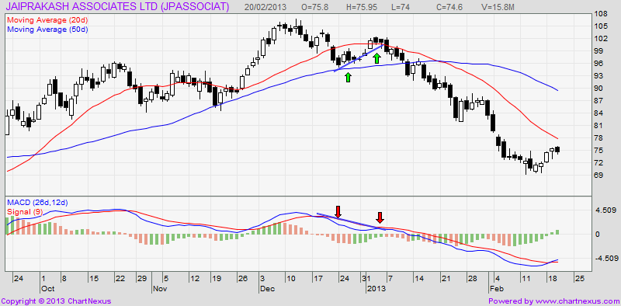
MACD Curve

Slide 12
Bollinger Band
It was developed by famous technical trader John Bollinger.
It is plotted two standard deviations away from a simple moving average.
WHAT IT IS?
Bollinger bands look like an envelop that forms an upper and lower band around the price of a stock or other security.

Slide 13
How Bollinger Bands help traders?
Buy & Sell Signals: When prices touches the upper band, it is a sell signal and when prices touches the lower band, it is buy signal.
%B (Percentage bandwidth):
if(%B > 1 or %B > 100%): means prices are above upper band
if(%B == 1 or %B == 100%): means price is at upper band
if(%B above .50 or 50%): means price is above the middle line
if(%B below .50 or 50%): means price is below the middle line
if(%B == 0 or 0%): means price is at lower band
if(%B<0 or 0%): means price is below lower band

Slide 14
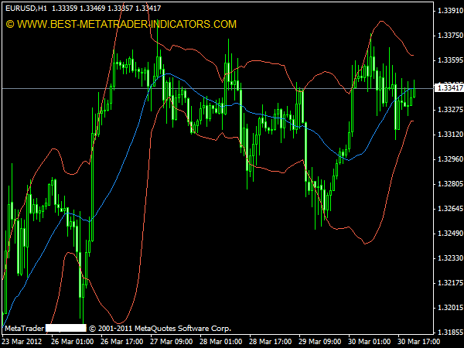
Bollinger Band

Slide 15
RSI(Relative Strength Index)
The Relative Strength Index (RSI), developed by J. Welles Wilder, is a momentum oscillator that measures the speed and change of price movements.
The RSI oscillates between zero and 100.
Overbought means an extended price move to the upside; oversold to the downside.
When price reaches these extreme levels, a reversal is possible.
The Relative Strength Index (RSI) can be used to confirm a reversal.

Slide 16
How RSI help investor?
RSI is considered overbought when above 70 and oversold when below 30.
The RSI is also used for determining and confirming the trend.
RSI tends to fluctuate between 40 and 90 in a bull market (uptrend) with the 40-50 zones acting as support.
RSI tends to fluctuate between 10 and 60 in a bear market (downtrend) with the 50-60 zone acting as resistance.

Slide 17
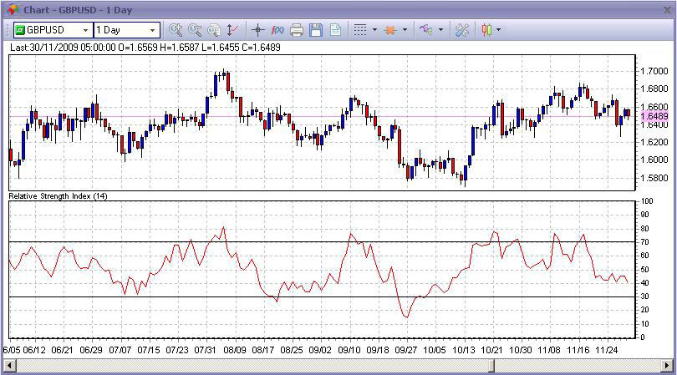
RSI Curve

Slide 18
Regression
In statistical modeling, regression analysis is a statistical process for estimating the relationships among variables.
It will give us a linear equation using which we can confirm the trend in stock market.

Slide 19
ANN
It is true that the stock market is not predictable. There is no perfect algorithm or model. Indicators and oscillators are also not perfect.
But since our aim is to provide a smart investing decision making, so we are trying to implement every possible thing that can help.
Using ANN, we would try to predict stock prices.

Slide 20
References
Appel, Gerald (2005). Technical Analysis Power Tools for Active Investors. Financial Times Prentice Hall. p. 166. ISBN 0-13-147902-4.
J. Welles Wilder, New Concepts in Technical Trading Systems, ISBN 0-89459-027-8
Bollinger, John. Bollinger on Bollinger Bands. McGraw Hill, 2002. ISBN 978-0-07-137368-5
NIST/SEMATECH e-Handbook of Statistical Methods: Single Exponential Smoothing at the National Institute of Standards and Technology

Slide 21
THANK YOU

